Slide 1
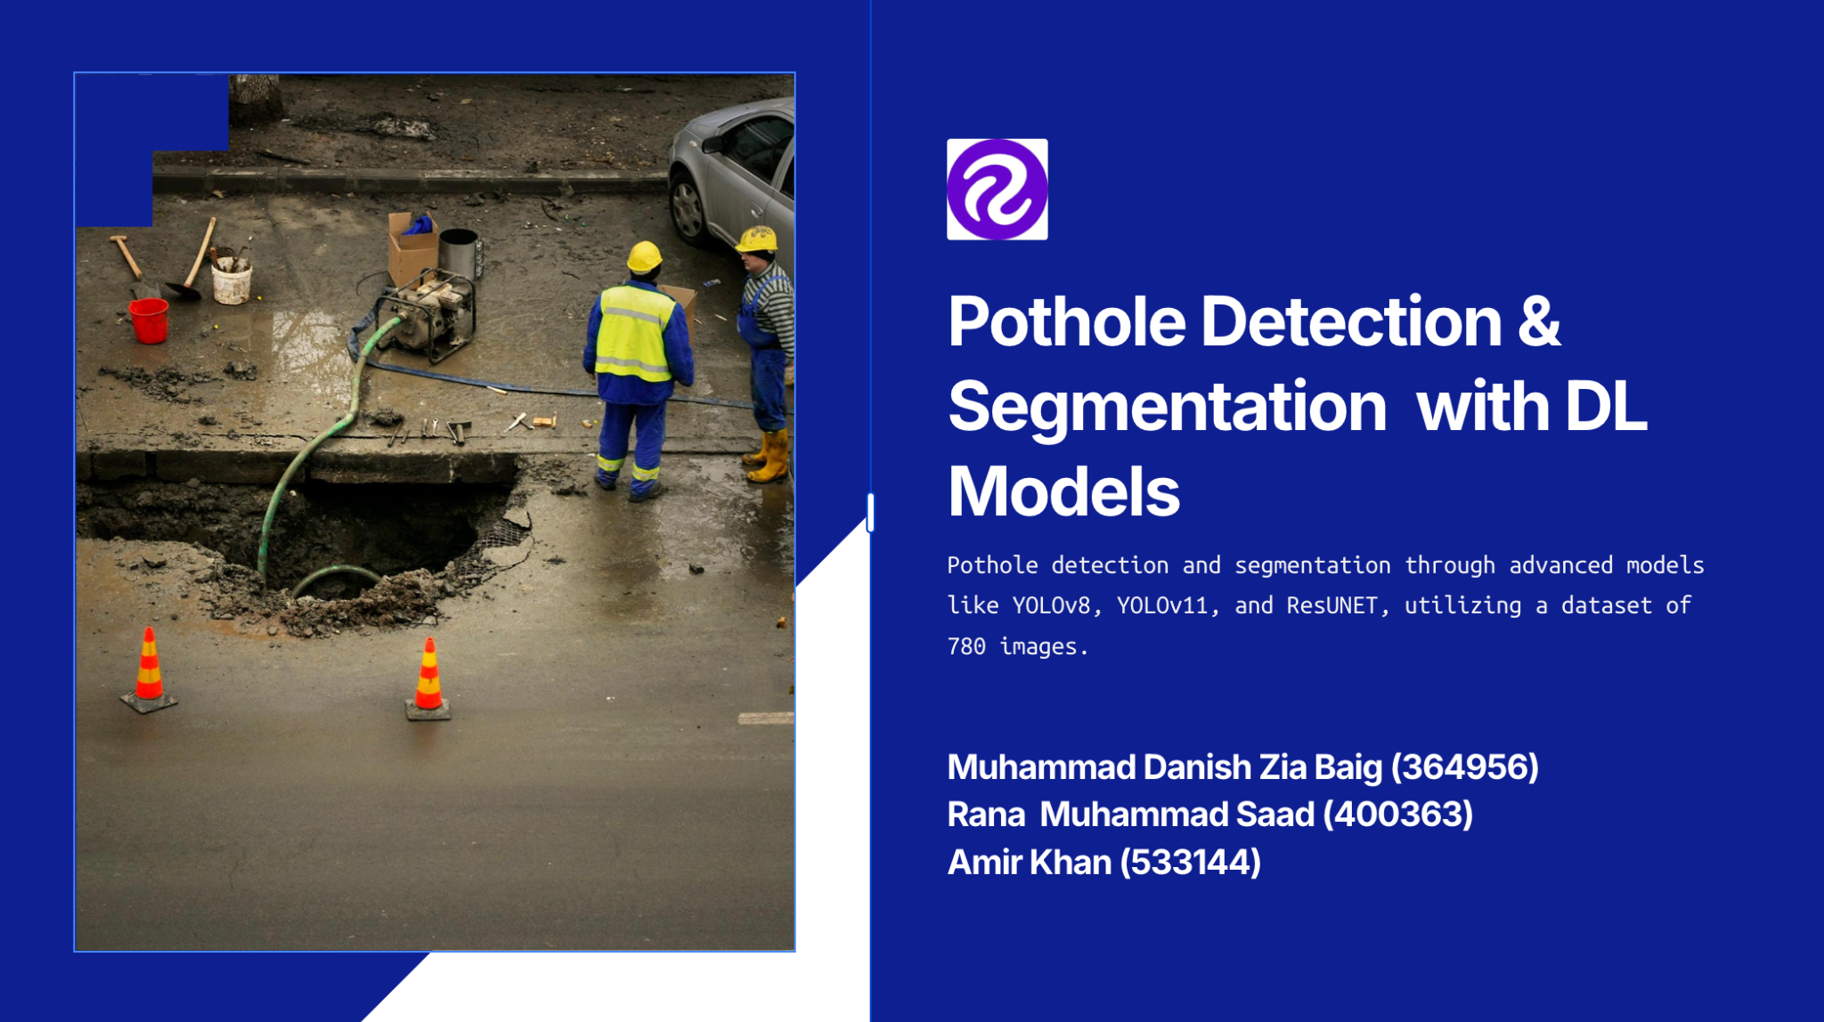

Slide 2
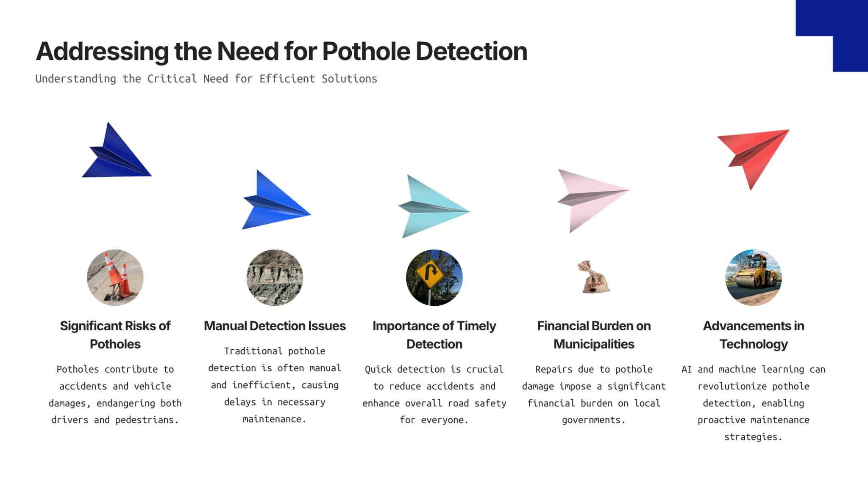

Slide 3
Dataset
Detection Dataset:
780 images of different scenes
Labels in the form of polygonal coordinates
Segmentation Dataset:
780 images of different scenes
Generated grayscale/binary masks from the polygonal coordinates
Dataset Split:
70-30% train/test split
Linchao Li, Jiazhen Liu, Jiabao Xing, Zhiyang Liu, Kai Lin, and Bowen Du, “Road Pothole Detection Based on Crowdsourced Data and Extended Mask RCNN”, IEEE Transactions on Intelligent Transportation Systems (Early Access), 2024

Slide 4
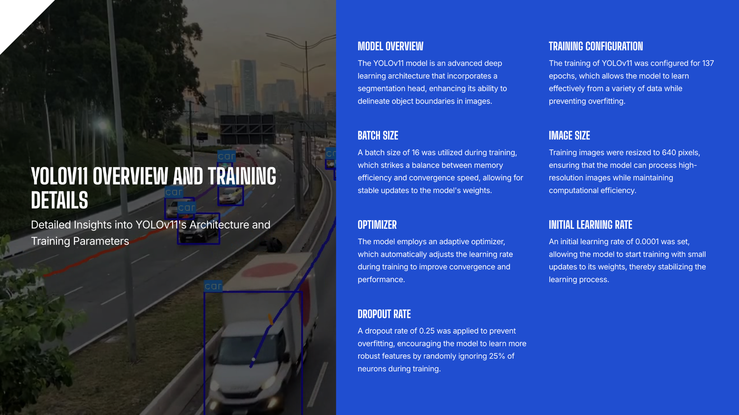

Slide 5
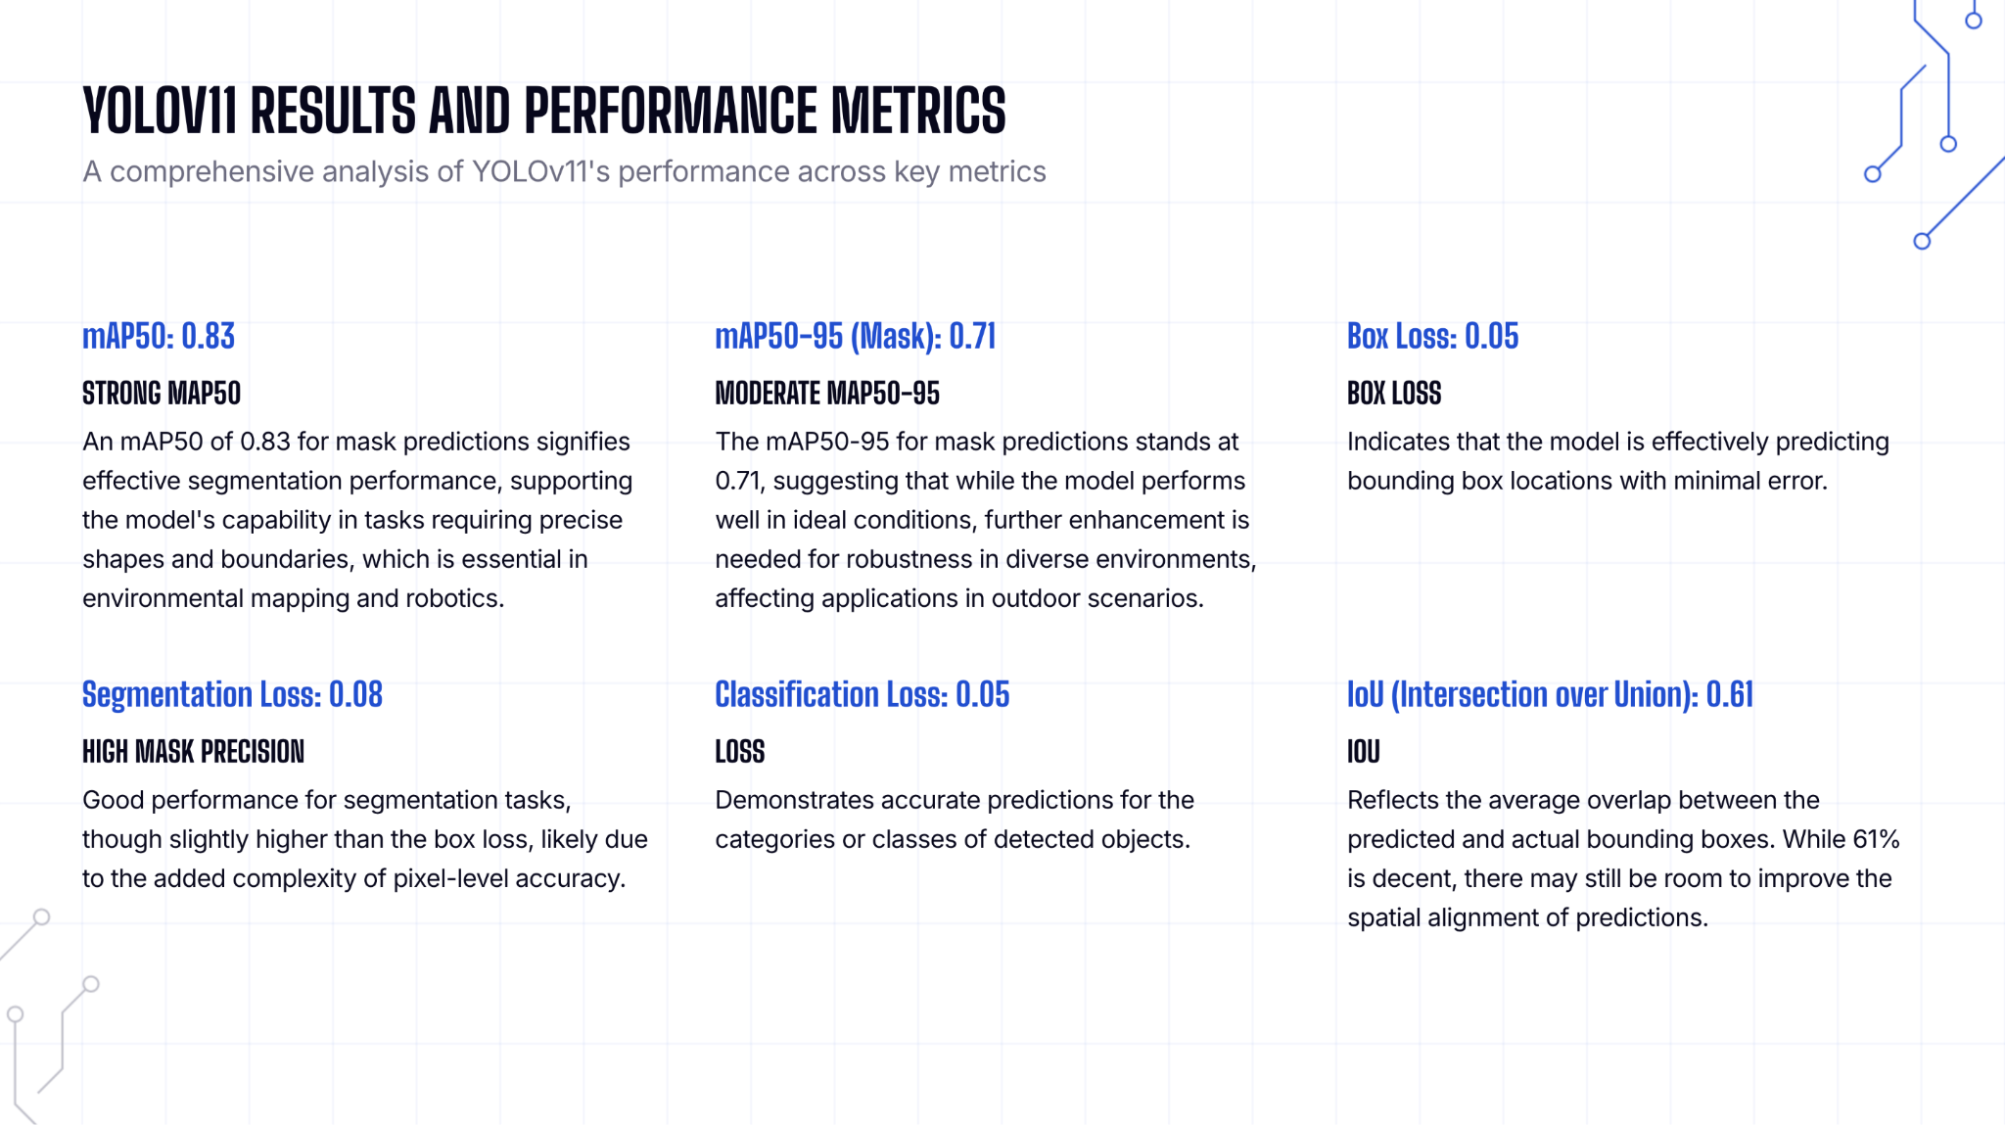

Slide 6
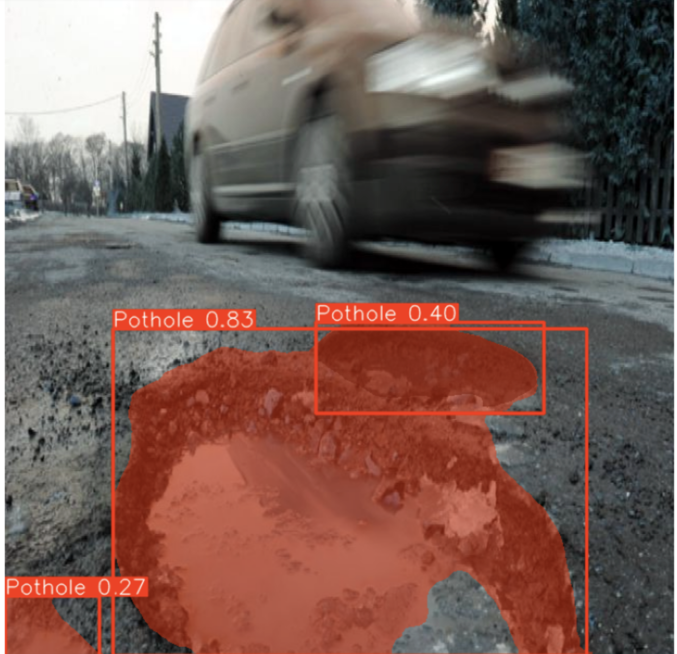
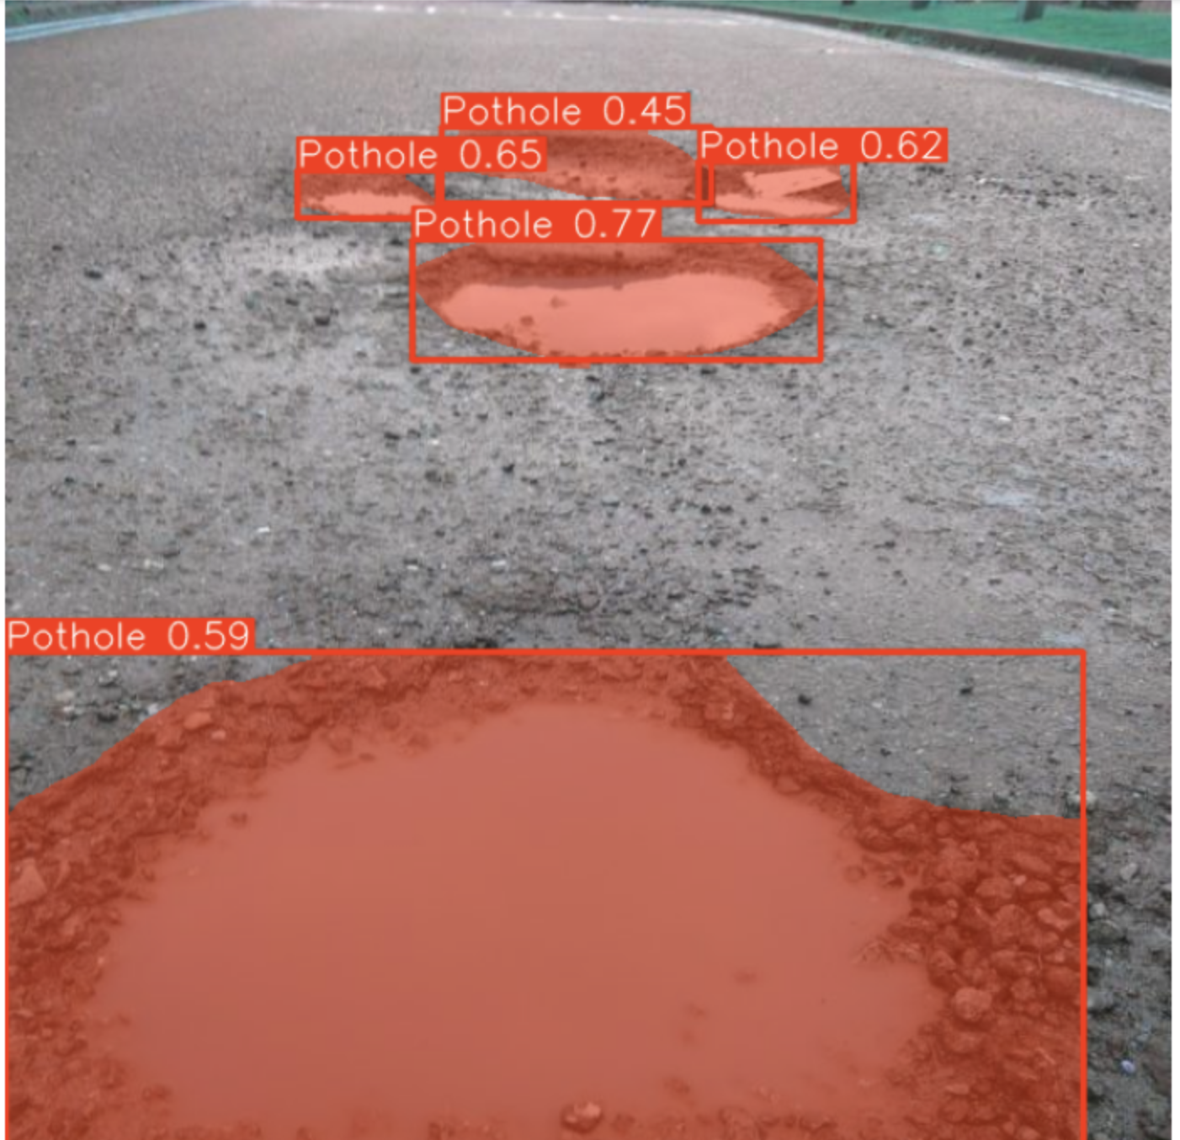
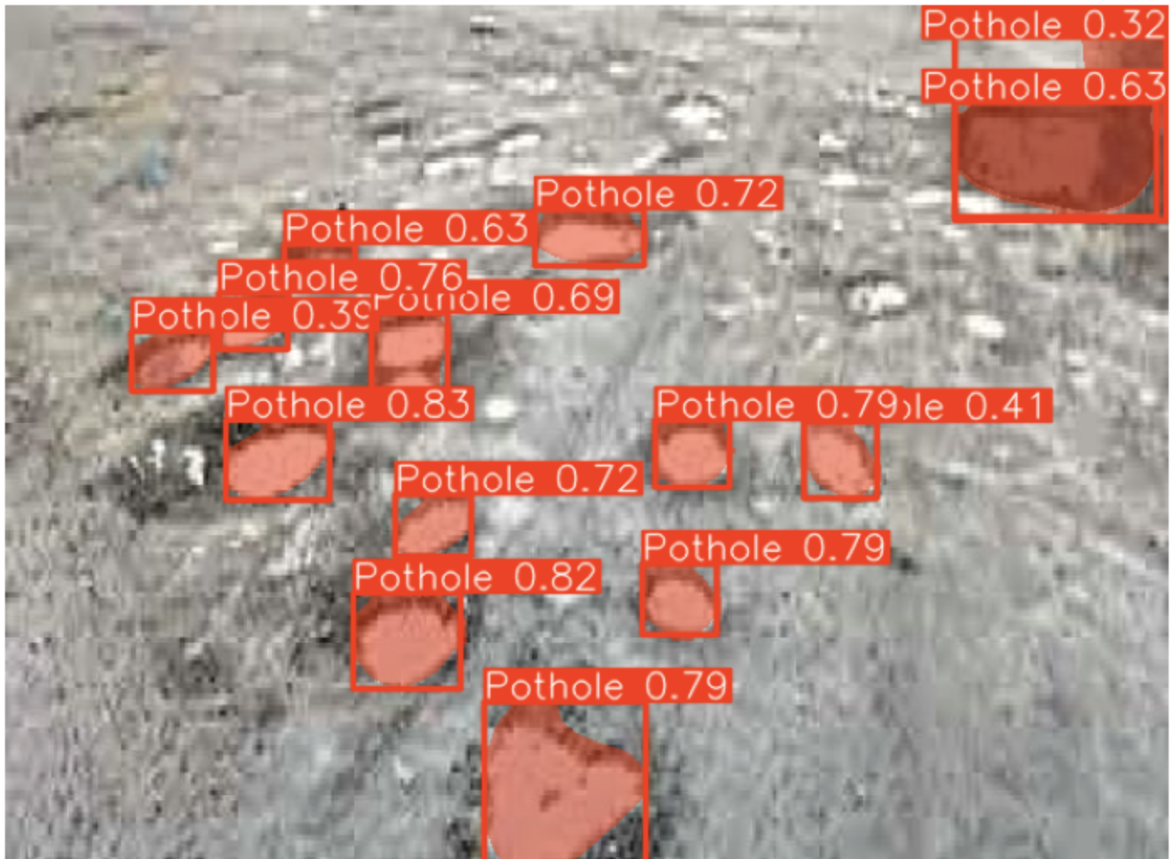
Yolov11 Results

Slide 7
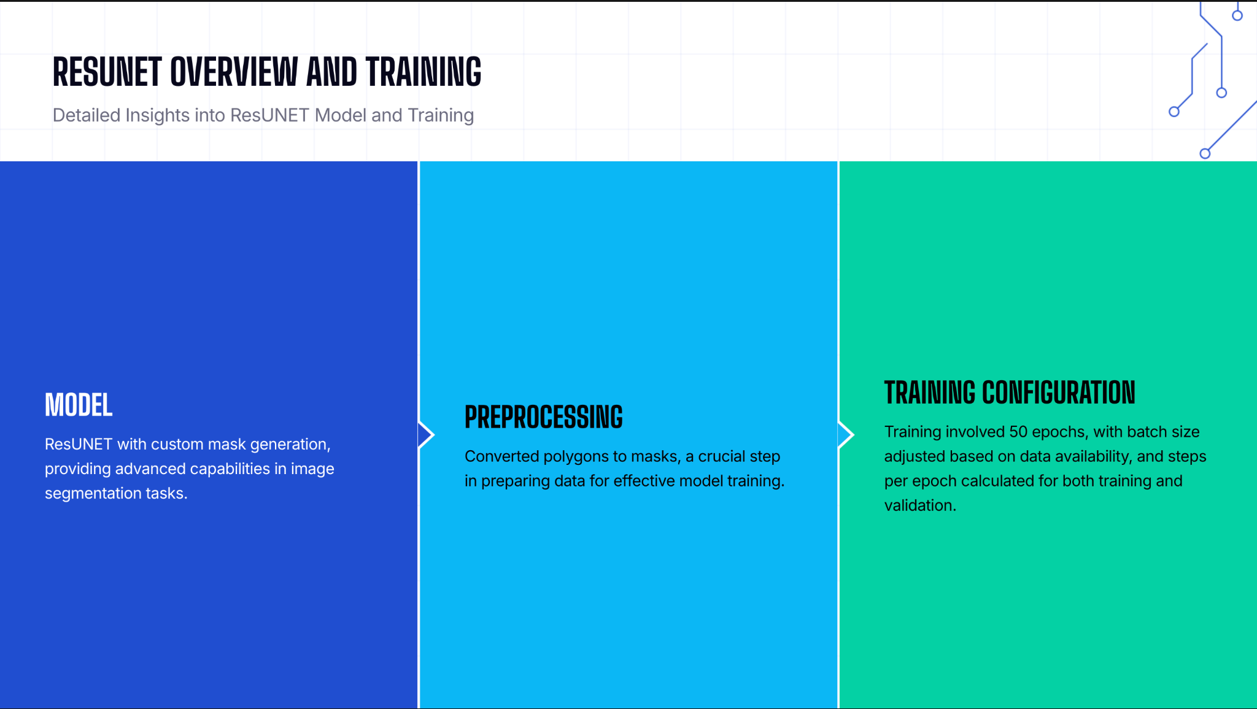

Slide 8
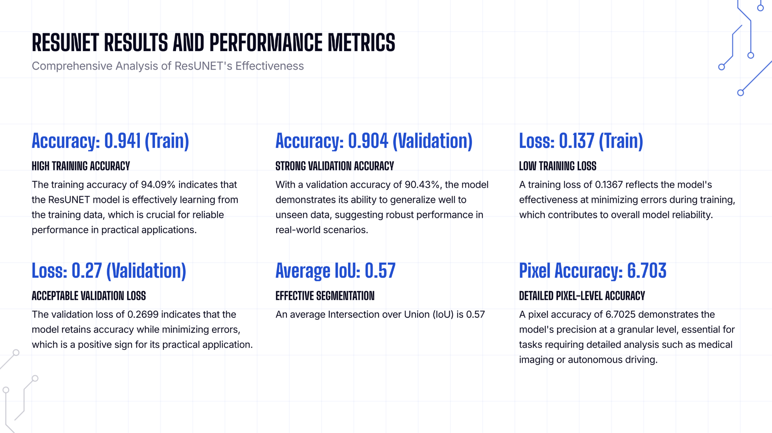

Slide 9
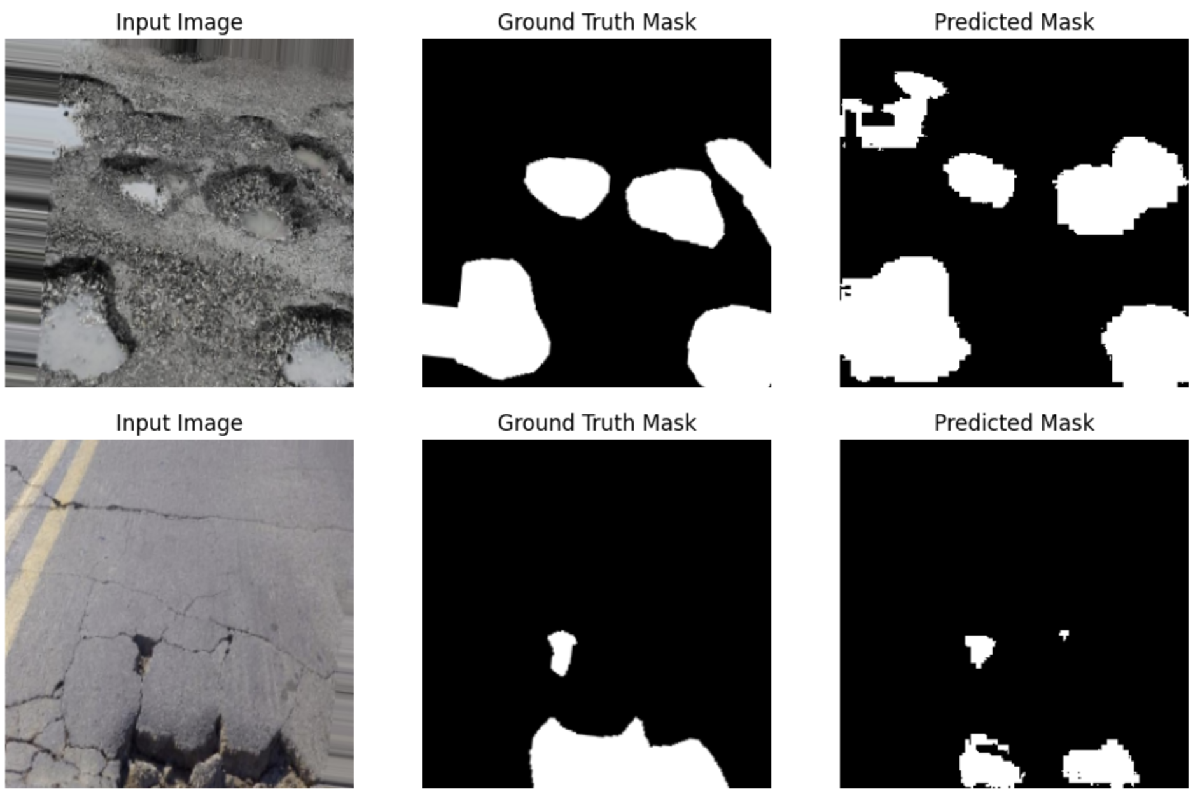

Slide 10
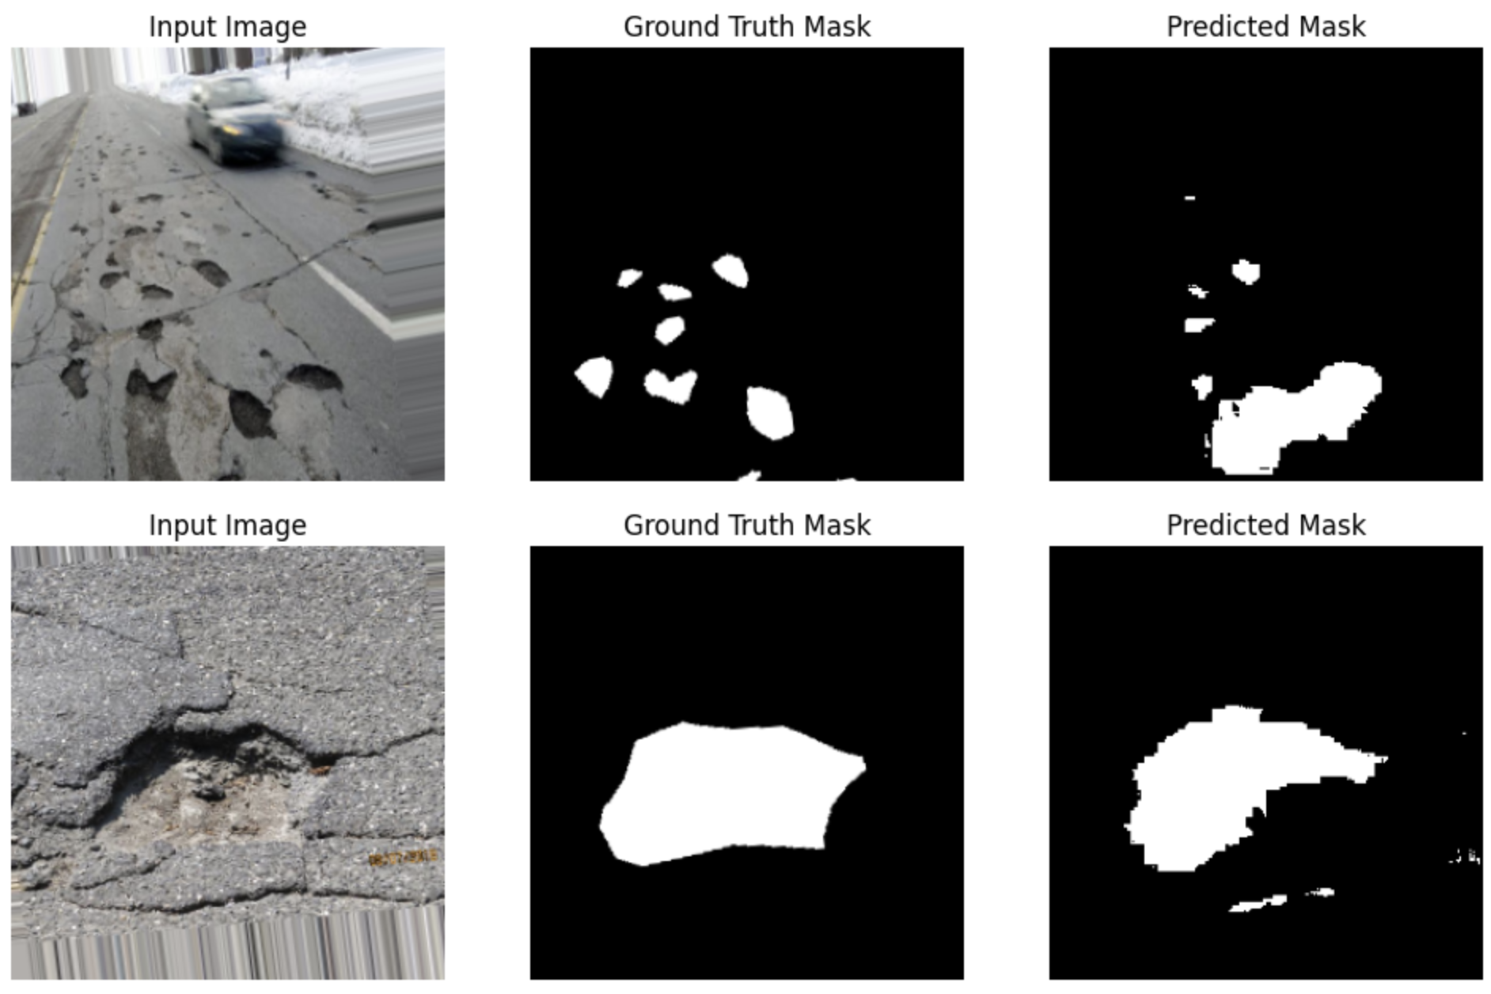

Slide 11
